Slide 1





JavaScript Fundamentals
Course Overview
Fundamentals
JavaScript Fundamentals
SoftUni Team
Technical Trainers
Software University
http://softuni.bg

Slide 2



Table of Contents
Course Objectives
Course Program
Trainers Team
Course Schedule
Exams and Evaluation
Learning Resources

Slide 3
Have a Question?
sli.do #6384

Slide 4









SoftUni Diamond Partners

Slide 5

JS Core Module @ SoftUni
JavaScript Core
Intensive 4 Months JavaScript Training

Slide 6
JS Core Module Goals
4 months intensive JavaScript development training
5 times weekly, lots of live coding, homework and projects
Part I – JS Fundamentals
JS programming, functions, arrays, strings, objects, JSON, …
Part II – JS Advanced
jQuery, DOM, object composition, classes, modules, unit testing
Part III – JS Apps
REST, AJAX, promises, MVC, ReactJS, routing, building SPA

Slide 7
JS Core Module at SoftUni – Timeline
19-Sep-2016
17-Oct-2016
14-Nov-2016
11-Dec-2016
23-Dec-2016
JavaScript
Fundamentals
Lessons + exercises + team work project + exam
4 weeks * 5 times / week
9 credits
Start: 19-Sept-2016
Final exam: 16-Oct-2016
JavaScript Advanced
Lessons + exercises + exam
4 weeks * 5 times / week
9 credits
Start: 17-Oct-2016
Final exam: 13-Nov-2016
JavaScript Applications
Lessons + exercises + team work project + exam
4 weeks * 5 times / week
9 credits
Start: 14-Nov-2016
Final exam: 11-Dec-2016
Re-Take Exams
3 exams @ one week
16-Dec
19-Dec
22-Dec
Christmas Holidays
2 weeks holiday

Slide 8
Professions @ SoftUni
Java
Fund.
Java
DB
Java
Web
Programming Basics
C#
Fund.
C#
DB
C#
Web
Tech Module
JS Core Module
MEAN
Stack
Web
Basics
PHP
Fund.
PHP
Web
Web
Basics
https://softuni.bg/curriculum
https://softuni.bg/trainings/courses

Slide 9

JavaScript Fundamentals
Fundamentals
Course Objectives & Program

Slide 10

Course Objectives
The JavaScript Fundamentals course provides
Basic coding skills for the JS language
Establishes fundamentals for further JS trainings
Content: JS syntax, data, arrays, objects, functions
What is NOT covered?
Object-oriented programming (OOP) in JS
DOM manipulation, JS libraries and frameworks (AJAX, jQuery, AngularJS, ReactJS)

Slide 11

Course Topics
JS intro, JS syntax, data types, expressions
Operators, conditional statements, loops
Functions and arrow functions (lambda)
Arrays and multi-dimensional arrays
Strings and regular expressions
Objects, JSON, associative arrays
Sets and maps, destructuring
Canvas 2D + DOM and events

Slide 12
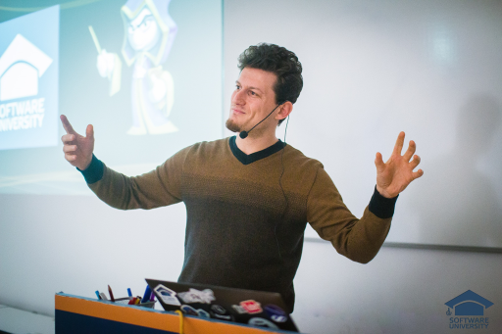
The Trainers Team

Slide 13
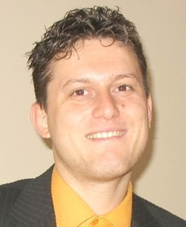
Trainers Team
Svetlin Nakov, PhD
Training & Inspiration Manager @ Software University (SoftUni)
20+ years software development experience
10+ years experience as trainer
Author of 7 programming books
Speaker at hundreds of events
Winner in International programming contests and Olympiads
Web site & blog: www.nakov.com

Slide 14
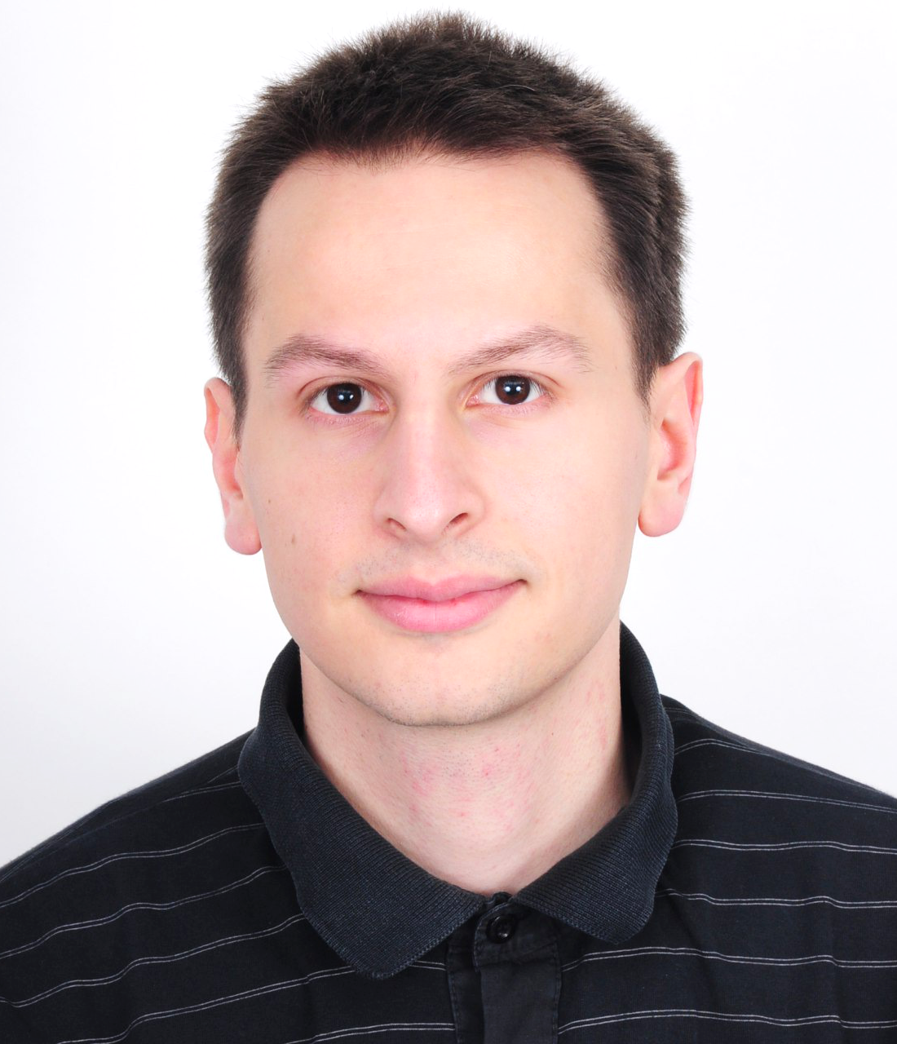
Trainers Team (2)
Viktor Kazakov
Technical Trainer @ Software University
Top performing student from the Software University
Interested in data structures and algorithms
Writes mostly in C#, but also knows C, C++, Java and JavaScript

Slide 15
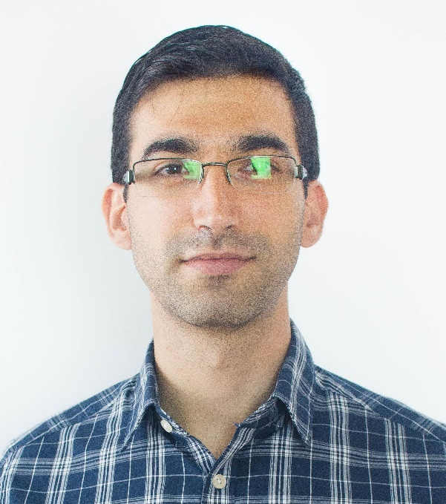
Trainers Team (3)
Viktor Kostadinov
Technical Trainer @ Software University
Programmed as a hobby since high school
Developed a resource-sharing website during his university years
Top performing student from the Software University
Interests include astronomy and game development

Slide 16
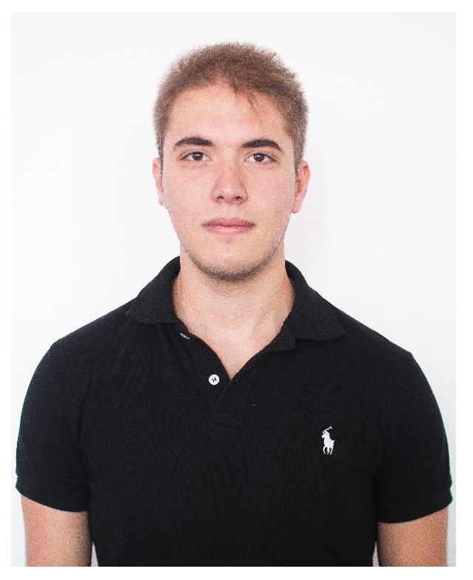
Trainers Team (4)
Ivaylo Zhelev
Technical Trainer @ Software University
Top performing student from the Software University
Interested in security and game development
Currently, writes mainly in JavaScript

Slide 17
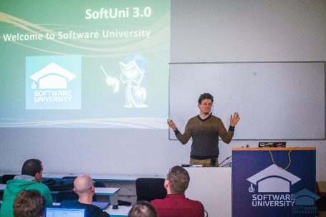


JavaScript Fundamentals
Course Details and Schedule

Slide 18
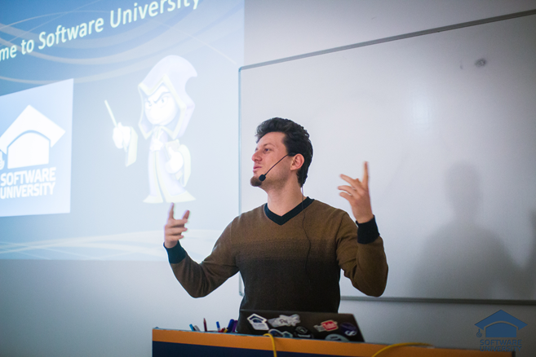
Training Duration and Schedule
Lessons: ~ 20 hours (onsite + YouTube videos)
Practical exercises (in class): ~ 40 hours
Homework: ~ 0-50 hours
Teamwork: ~ 20 hours
Teamwork defense: 0.5 hours
Time frame
19-Sept-2016 – 16-Oct-2016

Slide 19


Why English?
Why the slides are in English?
English is the native language of the software engineers
Specific terminology should be in English
Translations are inaccurate and funny
Just learn English!
No excuses

Slide 20
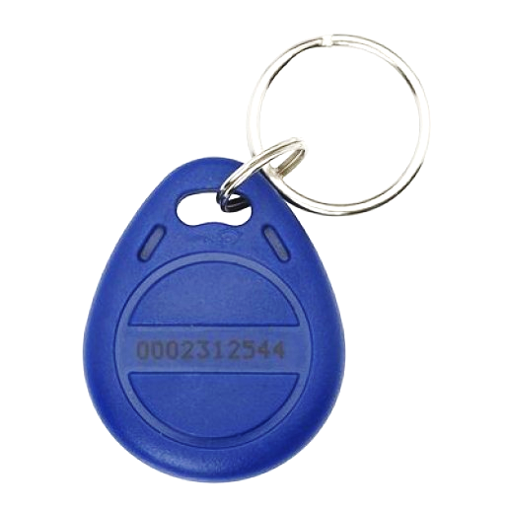

Your RFID Chip
Students can either
Take RFID chip from SoftUni
Or use their own chip / card (125 KHz)
Register your chip number in your SoftUni profile: https://softuni.bg/users/profile/show
Check-in at the reception every time when you come in SoftUni
See your last visits in your profile: https://softuni.bg/users/profile/show

Slide 21

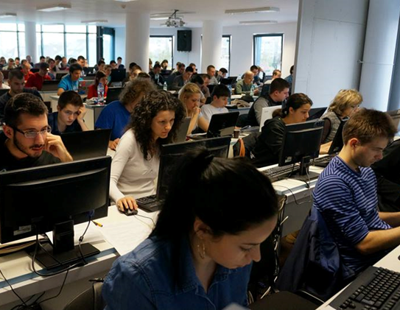
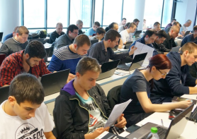
JavaScript Fundamentals
Evaluation Criteria

Slide 22
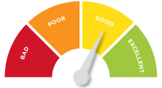

Scoring System for the Course
Mandatory:
Final exam – 85%
Exercises & homework – 15%
Bonuses:
Teamwork – bonus up to 10%
Presence in class – 5% bonus
Forum activity – bonus up to 5%

Slide 23


Homework Assignments & Exercises
Your homework is mainly work in class!
Lesson days → slides + live demos + exercises
Exercise days → only exercises
How to submit your homework?
Submitted in the judge system
Homework assignments are due in 5 days
Due for both lesson days and exercise days

Slide 24

Teamwork Project
Build a team of 3-6 persons
Choose your teammates
Develop a practical project
Choose from existing projects
Or work on your own idea
Public defense
Demonstrate your work live at SoftUni

Slide 25










Resources
What We Need Additionally?

Slide 26



Course Web Site, Forum and FB Group
Official web site:
Official discussion forum:
Official Facebook group:
softuni.bg/courses/javascript-fundamentals
softuni.bg/forum/categories/12
fb.com/groups/jscoresept2016

Slide 27

The Programming Basics Slides and Videos
All lecture slides, videos, homework assignments, projects and other resources are open content, available for free
Visit the course web site to access the course resources

Slide 28



Recommended Software
Software needed for this course:
Noje.js – https://nodejs.org
WebStorm – https://jetbrains.com/webstorm/
Optionally:
Visual Studio – https://www.visualstudio.com

Slide 29
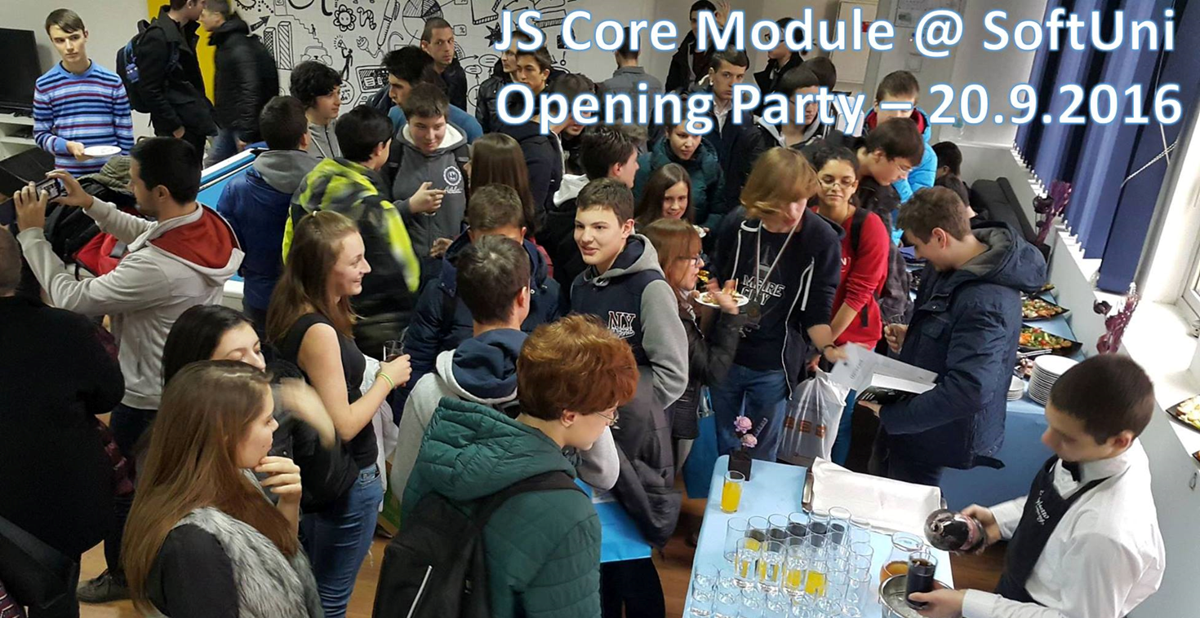
JS Core Opening Party

Slide 30
JavaScript Fundamentals – Course Overview
https://softuni.bg/courses/javascript-fundamentals

Slide 31
License
This course (slides, examples, demos, videos, homework, etc.) is licensed under the "Creative Commons Attribution-NonCommercial-ShareAlike 4.0 International" license

Slide 32






Free Trainings @ Software University
Software University Foundation – softuni.org
Software University – High-Quality Education, Profession and Job for Software Developers
softuni.bg
Software University @ Facebook
facebook.com/SoftwareUniversity
Software University @ YouTube
youtube.com/SoftwareUniversity
Software University Forums – forum.softuni.bg

